Slide 1


A Perspective of China’s 6G Strategy
Zhisheng Niu
(with the support from Prof. Xiaohu YOU)
Tsinghua University, Beijing, China
March 17, 2020
Notes:
Ladies and Gentlemen: Good Afternoon! My name is Zhisheng Niu from Tsinghua University, Beijing, China. First of all, I need to apologize for my absence due to the coronavirus outbreak. Also please allow me to make a minor change on the title of my presentation from the original one “China’s View on 6G”, which is too big to me, to the current one “A perspective of China’s 6G Strategy”. The main purpose of this talk is just to highlight some recent activities on 6G in China based on my best knowledge.

Slide 2
6G: Mobile 2030
Mobile Things/Control
Mobile Internet
Intelligence
Broadband
M-MIMO, UDN, NoMA, NFV…
5G/ B5G/ 6G？
LTE/LTE-Advanced, 802.16m
Mobile Phone
OFDM + MIMO
4G
CDMA
2020-2030
Digitalization
3G
2010s
TDMA
WCDMA, TD-SCDMA,
CDMA2000
2G
2000s
FDMA
1G
GSM, cdmaOne(IS-95)
1990s
1980s
AMPS, TACS
2
Notes:
Here by 6G, I simply mean the mobile communication networks in around 2030 without any specific definition on any particular technologies. If we have to say something on it, I think it could be called Mobile Things or Mobile Control embedded with more intelligence together with 5G, rather than just a Mobile Phone in 1G and 2G, as well as Mobile Internet in 3G and 4G.

Slide 3





China’s 5G: Spectrum
LOW: 600MHz
HIGH: 24.25-24.45GHz、24.75-25.25GHz、
47.2-48.2GHz、27.5-28.35GHz、37-40GHz
2016.07，FCC releases 5G spectrum
2019.01，28GHz Auction Completed
2016.07, MIC releases 5G policy
2019.03, 5G spectrum allocated
MID: 3.7-4.1GHz, 4.5-4.6GHz, 4.6-4.8GHz (Local 5G)
HIGH: 27-28.2GHz、29.1-29.5GHz, 28.2-28.3GHz (Local 5G)
2016.11，5G policy released
UK/Germany auction completed
LOW：700MHz
MID: 3.4-3.8GHz
HIGH：24.25-27.5GHz (TBD)
2018.06, 5G spectrum allocated
MID： 3.42-3.7GHz
HIGH：26.5-28.9GHz
LOW: 700MHz (CB)
MID：160M@2.515-2.675GHz (CM)
100M@4.8G-4.9GHz (CM)
100M@3.4G-3.5GHz (CT)
100M@3.5G-3.6GHz (CU)
60M@4.9GHz (CB)
HIGH：24.75-27.5GHz (TBD)
2018.12, 5G trial spectrum allocated
2019.06, LOW & MID spectrum allocated, HIGH pending
New operator: China Broadcast
CM: China Mobile; CT: China Telecom
CU: China Unicom; CB: China Broadcast
Notes:
Therefore, to better understand what 6G should be, we need first to understand what 5G is or will be. As one of the leading markets in the world, Chinese operators have started to build their 5G trial networks since December 2018. On June 6, 2019, Chinese government released commercial 5G network licenses to 4 operators by allocating the low- and middle-band spectrum as shown here. Here, please note that, except the existing 3 major operators in China, China Mobile, China Telecom, and China Unicom, a new operator called China Broadcast also got a commercial license for 5G. This is indeed a big change in Chinese Mobile Market. It does not only mean just another competitor, but also mean more broadcasting-type applications will be integrated into communication networks. For example, China Broadcast has announced a close collaboration with China State Grid to empower a nationwide Smart Grid in China using 5G technologies. Another point you may have noticed is that high-band spectrum, i.e., mmWave spectrum, has not yet been allocated at this moment.

Slide 4





China’s 5G: Trials and Commercialization
“5G+”
7MegaCity
+
33 LargeCity
+
n Verticles
SA-enable：NSA/SA in 40+ cities
5G+Cloud：Cloudified Smart Networking
“5S”Strategy (to C): Smart Broadband/Home/Apps/SecurityServices
5G+ Verticals (to B): Building/Transportation/Energy/Police/Education/ Medical
ChinaMobile: 30K-50K 5G BS in 2019, investing 17.2 billion RMB
ChinaTelecom: 20K 5G BS in 2019, investing 9 billion RMB
ChinaUnicom: 20K 5G BS in 2019, investing 6-8 billion RMB
(2019.09.09 announced: CT and CU will jointly build 5G network）
Notes:
To be more specific, the three major operators in China have announced their 5G service packages as well as their commercialization plan. China Mobile will build 30-50 thousand 5G BSs by investing 17.2 billion RMB in 2019, while the other two operators will have 20K 5G BSs each. Here, an interesting thing is that China Telecom and China UniCom have decided to jointly build the 5G networks in order to compete with China Mobile. This is not only because the very initial high investment cost, but also because the very limited resource to find a location for the ultra-dense 5G BSs.

Slide 5





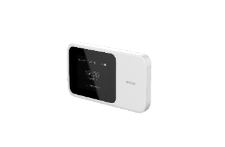




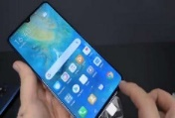

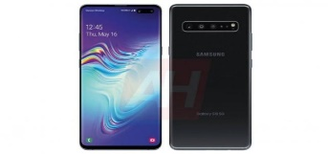



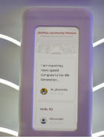

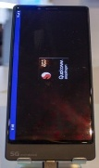

China’s 5G: Chips and Handsets
Chip
NSA/SA Dual
Qualcomm X55 NSA/SA Dual (TBA)
TBA by 2020.12
Qualcomm X50，NSA only
HiS Balong5000，NSA/SA Dual， 2/3/4/5G Coexist
Exynos 5110 NSA only
TBA in 2020 Q1 (NSA) and Q2 (SA)
N/A
2019.Q2
2019.Q3
2019.Q4
Handset
5G CPE Pro (Indoor)
Dual Mode
Mate 20X（5G）
5G WiFi
MATE X
HUAWEI
5G CPE WIN
(Outdoor)
5G CPE
SAMSUNG
Galaxy S10 5G
LG
ThinkQ V50 5G
MI
MIX 3 5G
ONE PLUS
One Plus 7 5G
OPPO
Find X2 5G
SONY
Prototype AG-1
VIVO
APEX2019
40+ 5G Handsets available (2019.12). Only HUAWEI supports NSA/SA
MII requests the support of NSA/SA from 2020.01
MII: Ministry of Industry and Information
Source: China Academy of Telecom Research
Notes:
For the chips and handsets, more than 40 handsets have been available by the end of 2019 from Huawei, VIVO, OPPO, MI, ONE Plus, SAMSUNG, and LG. But, among them, only Huawei supports NSA and SA mode simultaneously. The Ministry of Industry and Information Technology has requested the support of both NSA and SA from this year.

Slide 6
China’s 5G: Killer Applications
Killer Apps: 4K/8K、AR/VR、UAV、MobiRobot take ~50% share
Verticals: Industrial Internet (Manufacturing, Power, Telemedicine)
e-Commerce: Mobile payment in 2018 (81% China vs 25% Japan & 12% France)
Source: China Academy of Telecom Research
Notes:
For the killer applications, a survey by Chinese Academy of Telecom Research has shown that 4K/8K high-definition video, AR/VR, UAV surviliance, remote control of mobile Robots and Industrial Interent are the most promising apps, which take a share of 50%. Of course, mobile pays are also very popular in China.

Slide 7
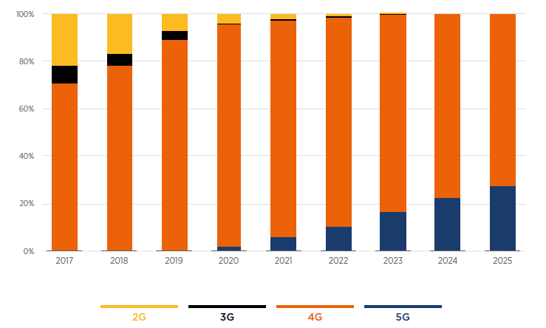
China’s 5G: Facts and Prediction
28%
(0.46bn>
NA+EU)
Connections (%) in China by technology (Source: GSMA Intelligence)
Licensed cellular IoT connections in 2025: 1.9bn
Notes:
According to the recent prediction by GSMA, 5G users in China will grow up to 460 million by 2025, which will in fact exceed the total scale of North America and the whole Europe, although it just accounts for less than 30 percent of the whole China mobile market. In addition, there will be 1.9 billion licensed IoT connections go through cellular networks in 2025.

Slide 8
China’s 5G: Investment vs Revenue
Revenue (Billion): Increasing but Plateau
(Source: GSMA Intelligence)
In 2010-2018, mobile operators in China spent $268bn (RMB1.9tn)
In 2020-2030, MII predicts the investment will be $405bn (RMB2.8tn)
Notes:
But, one of the big problems with this fast growing of 5G services is the mis-match of the investment and revenue. As shown in this graph, by increasing the investment by 50%, we can only improve the revenue by 10%. This is mainly because, in order to obtain an enhanced Mobile Broadband, 5G have to use much higher frequency and therefore have to deploy much more BS to keep the coverage. As a result, the running cost of 5G network will be at a very high level. Nevertheless, the tariff is yet fixed rate and best-effort. This is a very dangerous sign for the sustainable development of not only 5G but also probably 6G in the future.

Slide 9
5G: What’s Missing?
eMBB
AUTONOMOUS
(L4 On-demand & Autonomous Service Provisioning)
GREEN
(10X Energy-Efficiency & Energy-Sustainability)
uRLLComm
mMTC
uRLLCtrl
(uRLLComm + uRLLComp for Mission Control )
TRUST
(Trust-Worthy & Unlimited Connectivity)
Notes:
So, clearly, 5G is not perfect at all. It probably has to be focused on eMBB and mMTC, but leave most of the parts of uRLLC to 6G. This is because, as mobile things or industrial internet grows, one needs to remotely control different kinds of machines such as vehicles and robots through sensing, learning, and actuating. Therefore, ultra high reliable and low latency guarantee of the sensed information as well as the action decision is crucial. This is why we need to extend the uRLLCommunication to include uRLLComputing for timely and adaptive mission controls. In addition, 6G needs to add another three key words on top of 5G, which are Autonomous, Green, and Trust.

Slide 10
6G: Filling gaps b/w 5G Promises & Reality
uRLLCtrl: uRLLComm + uRLLComp for mission control
  e2e latency and reliability guarantee (communication + computing)
    information delay: sensing/learning, updating, scheduling, transmitting, execution,
  Beyond Mean: reliability = delay bound violation probability
  Beyond AoI (Age-of-Information): context-aware UoI (Urgency-of-Information)
AoI=4 slots
8
8
7
6
5
5m/s
Destination
(fusion & Decision center, controller)
…
…
AoI=2 slots
…
Transmission
7m/s
9
7
6
Execution
Sensing/Updating
Scheduling
X. Zheng, S. Zhou, and Z. Niu, ‘‘Beyond Age: Urgency of Information for Timeliness Guarantee in Status Update Systems," 6G Summit 2020 (TS17), Levi, Finland, 2020

Slide 11
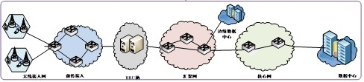
6G: Filling gaps b/w 5G Promises & Reality
AUTONOMOUS: On-demand & autonomous service provisioning
  Multi-dimensional and multi-scale sensing and timely status updating
  Edge learning and AI-based decision-making
Self-learning, Self-organizing, Self-optimizing, Self-evolving
Big Data
Machine Learning
Decision-making
sensing
E2E network slicing and KPI management
eMBB slice
mMTC slice
uRLLC slice
GREEN slice
TRUST slice
……
RRU
Fronthaul
Baseband
Edge cloud
Core Net
Remote cloud
Notes:
Here, by Autonomous, I mean on-demand and autonomous service provisioning. That is to say, by sensing the traffic and the network context information, network itself can Self-learn, Self-organize, Self-optimize, and Self-evolve by using the Big Data and Machine Learning technologies. Based on that, the network controller will adjust the network slicing and the E2E KPI management. For this purpose, we need to study Multi-dimensional and multi-scale sensing and timely status updating, and Edge learning and AI-based decision-making technologies.

Slide 12
6G: Filling gaps b/w 5G Promises & Reality
GREEN: 10X Energy-Efficiency & Energy-Sustainability
  Hyper-cellular network with BaseStation and EdgeServer sleeping
  Renewable Energy and Energy Harvesting
Notes:
By GREEN, I mean not only energy-efficiency, but also the energy-sustainability. As we have known, the energy consumption of a typical 5G BS is 3-4 times of that of a 4G BS AND, in order to provide a similar coverage it may need 3-4 times of the 5G BSs compared with 4G BS. As a result, the energy consumption as well as the total cost of 5G networks would be much higher than 4G networks. One of the potential solution is to more aggressively turn off the under-utilized BSs as well as EdgeServers. Another potential solution is to incorporate more renewable energy by energy harvesting technologies. Therefore, the hyper-cellular network architecture, which can adapt to the traffic variation by controlling the BS or EdgeServer sleeping, need to be implemented.

Slide 13
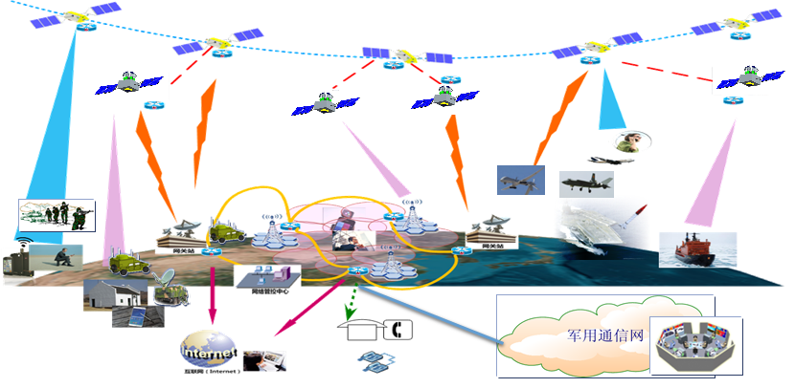
6G: Filling gaps b/w 5G promises & reality
TRUST: Trust-Worthy & Unlimited Connectivity
  Infrastructure-assisted Authentication and Block-chain
  Space-Air-Ground Integrated Network
Private NWs
Notes:
Last, but not the least, by TRUST, I mean not only the trust-worthy computing, communication, and control, but also ubiquitous and unlimited connectivity, which is extremely important in 6G. For this purpose, to only list up a few, for example, the infrastructure-assisted authentication and block-chain technologies as well as Space-Air-Ground integrated networks would be the keys.

Slide 14
    Pre-Study of B5G/6G in China
Jan. 2018: National Key R&D Project (2016-2020, MOST) incubated B5G/6G researches
  Fundamental theory for massive communications
  mmWave & THz communications
  Space-Air-Ground Integrated Networks
  Network Intelligence
Mar. 2018: National Major S&T Project (2006-2020, MOST) incubated “Mobile Information Networks” researches
  Full Coverage; Full Spectrum; Full Applications
May 2019: MII IMT-2020 kicked off 6G Technical WG
Nov. 2019: MOST Kicked off “National 6G Expert Committee” (next page)
Notes:
Based on the above-mentioned understandings, China has started the pre-researches on 6G, while supporting the commercialization of 5G networks. On Jan 2018, the Ministry of Science and Technology of China (MOST) has started to incubate the B5G and 6G researches on these four topics through the funding framework of “National Key R&D Project” which is a 5-year research funding program. Only two month later, the MOST set up a new research category called “Mobile Information Networks” under the framework of “National Major S&T Project”, which is a 15-year research funding program, through which a new concept called “FULL Coverage, FULL Spectrum, and FULL Applications” have been proposed. Then, on May 2019, the Ministry of Industry and Information Technologies (MII) kicked off a 6G Technical Working Group within IMT-2020 organization. Most recently, on Nov. 2019, the MOST kicked off a even bigger “National 6G Expert Committee”, consisted of 37 experts from government, adacemia, and industry.

Slide 15
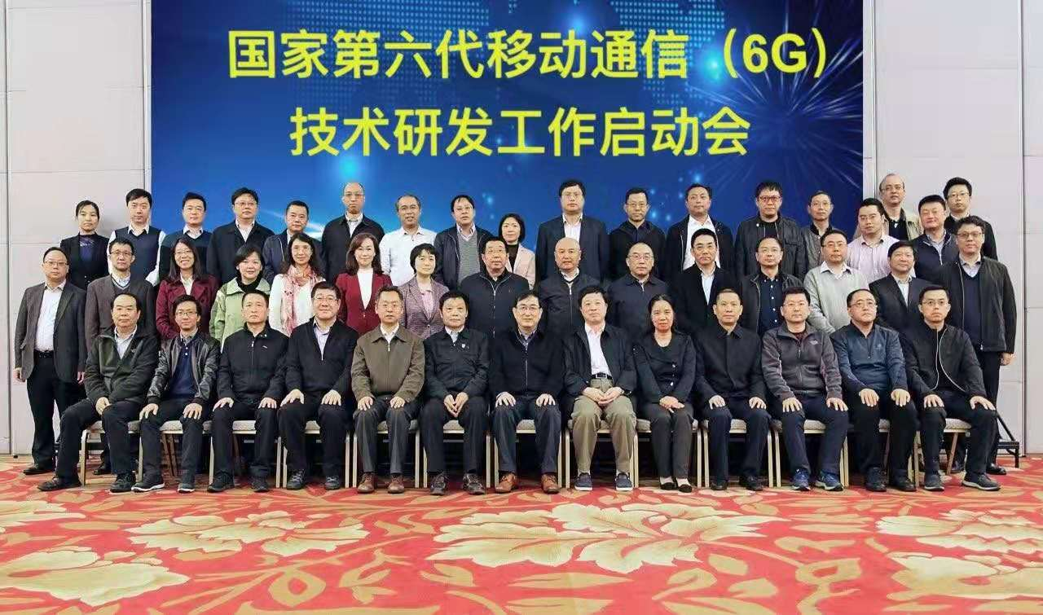
China’s 6G Expert Committee
Kicked-off on Nov.3, 2019 (32 experts from gov/edu/com)
1st Meeting on Nov.16, 2019 (Vision & Needs)
2nd Meeting on Dec.4, 2019 (project guideline, intl cooperation)
6G project guideline to be released in 2020Q1 (under the framework of “National Key R&D Project”, MOST)
Notes:
This Expert Committee is the highest level committee in charge of the high-level researches on 6G vision and use-cases, as well as the project guideline and international collaboration with the peer entities such as 6G flagship. We are expected to release the Call for Proposals for 6G researches very soon under the framework of National Key R&D Project. The proposals from outside China should also be welcome, I guess.

Slide 16
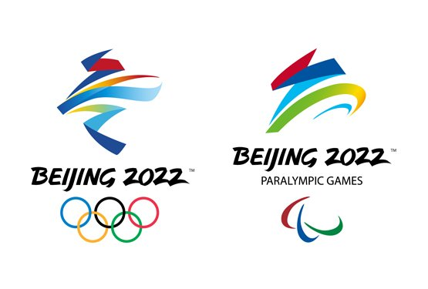
Welcome to
2022 Beijing Winter Olympic and Paralympic Games
Notes:
I stop here. Thank you very much for your kind attention.

